Slide 1
D-Smart ML
Distributed Auto ML Library

Slide 2
1) D-Smart ML Overview

Slide 3


D-Smart ML Overview
The D-Smart ML library main objective is to do automatic machine learning by receiving a dataset as input and return the best Machine Learning model as output with minimum resources (ex: Time) without the need of selecting the algorithm or its hyperparameters manually.
Extract Metadata
Select Based Algorithm
(based on the KB)
Get Best Hyperparameters
(Using Hyperband)
1
2
3
Dataset
Best Model

Slide 4
D-Smart ML Parameters
Parameter | Description | Data Type | Default
eta | an input that controls the proportion of configurations discarded in each round of SuccessiveHalving (in hyperband) | Integer | 5
Max Data Percentage | the maximum amount of resource that can be allocated to a single configuration | Integer | 80 %
Parallelism | the maximum amount of resource that can be allocated to a single configuration ( models will only be run in parallel if there are enough resources available in the cluster. Otherwise, models will be queued in the Spark scheduler and have to wait for the current jobs to complete before being run.) | Integer | 1
Try N Classifier | Number of Algorithms should be checked (out of the best algorithms based on the kB) | Integer | 2
Hyperband Max Time | Maximum Time allowed for Hyperband (per each Algorithm) to get the best hyperparameter values (in Seconds) | Integer | 1,800 Second
Convert To Vector Assembly | If the input dataset features need to be converted to Vector. | Boolean | false
Target Column | The name of the label column | String | y
Feature Column | The name of the Feature column | String | features

Slide 5
D-Smart Main Components
Model Selector
KB Manager
Metadata Manager
KB Model
Hyperband
Classifier Manager
Best Model
Input Dataset
Grid Search
Parameters
Logger & Exception Handler

Slide 6
2) Algorithm Selection

Slide 7
Metadata Extraction
For each dataset, a set of meta-data extracted that represent statistics and description for this dataset, the extracted meta data can be grouped as following:
General Characteristic:
Example: (Number of instances - Number of Features - Number of Classes - Number of numerical Features - Number of Categorical Features - Ratio between Categorical & Numerical - Number of Missing Value)
Classes Characteristic:
Example: (Class Entropy - Classes Probabilities [Min – Max – Standard Dev - Mean ])
Categorical Features Characteristic:
Example: (Sum of all symbols - Mean of all symbols - Standard Deviation for all symbols)
Numerical Features Characteristic:
Example: (Skewness for all Numerical features - Kurtosis for all Numerical features)

Slide 8

Knowledge Base
The Knowledge base contains the metadata of 76 datasets with the best algorithms for each dataset
The Knowledge base order the algorithms based on the accuracy (using the default hyperparameters value).
We are using 9 Algorithms in the Knowledgebase :
Random Forest
Logistic Regression
Decision Tree
Multilayer Perceptron
Linear SVC
Naïve Bayes
GBT
LDA
QDA
The Knowledge base contains 30 features used to represent each datasets
For each dataset we have 9 records, record per classifier.

Slide 9
Get Best Algorithm (1)
In the Knowledgebase the Algorithm with the best Accuracy and all Algorithms within 1 Standard Deviation rang will be marked as Good, other than that will be marked as bad
Features
Label
Dataset Statistics and characteristics | Classifier | Good/Bad
9 Algorithms Accuracy:
33%
39%
45%
50%
59%
60%
81%
85%
91%
10 | 20 | 30 | 40 | 50 | 60 | 70 | 80 | 90 | 100
1 Std. Dev
20.93%
Average
Best Accuracy
60.33%

Slide 10
Get Best Algorithm (2)
We have used GBT Classifier to determine which algorithms (out of the 9 algorithms) is good or bad for each dataset based on its metadata.
The Model saved and used to predict any new dataset
The metrics of this saved models are:
- Accuracy: 79.33 %
- Precision: 75.47 %
- Recall: 76.92 %
- F-Score: 76.19 %

Slide 11
3) Hyper-parameters Optimization

Slide 12
Hyperband
We are using Hyperband in order to determine best hyperparameters quickly, hyperband based on Successive Halving algorithm which allocates exponentially more resources to more promising configurations, the algorithm do the following:
Uniformly allocate a budget to a set of hyperparameter configurations
Evaluate the performance of all configurations
Throw out the worst half
Repeat until one configuration remains
we have used number of instances (data sampling) as the hyperband resource, so the maximum resources that can be allocated is 100% of data.

Slide 13
Hyperband (1)
Based on Successive Halving, it consists of two loops:
the inner loop invokes SuccessiveHalving for fixed values of n and r
the outer loop iterates over different values of n and r
Hyperband Input:
R, the maximum amount of resource that can be allocated to a single configuration
η, an input that controls the proportion of configurations discarded in each round of SuccessiveHalving

Slide 14
Hyperband (2)
Bucket 1
(Successive Halving)
n = 81
Bucket 2
Successive Halving
n = 27
Bucket S max
Successive Halving
…..

Slide 15
Session One
Session Two
Session Three
All Hyperparameters Values
Hyperparameters:9
Hyperparameters:81
Hyperparameters:27
depth | Bins | Trees | impurity
5 | 32 | 10 | gini
5 | 32 | 10 | entropy
5 | 32 | 20 | gini
5 | 32 | 20 | entropy
5 | 32 | 30 | gini
5 | 32 | 30 | entropy
5 | 64 | 10 | gini
5 | 64 | 10 | entropy
5 | 64 | 20 | gini
5 | 64 | 20 | entropy
5 | 64 | 30 | gini
5 | 64 | 30 | entropy
5 | 128 | 10 | gini
5 | 128 | 10 | entropy
5 | 128 | 20 | gini
… | … | … | …
10 | 128 | 30 | gini
Hyperparameters:81
Data Percentage:1.23%
81 run
Best 30%
Hyperparameters:27
Data Percentage:3.7%
Randomly Get 81
Hyperparameters
value
27 run
Best 30%
Hyperparameters:9
Data Percentage:11.11%
9 run
Best 30%
Hyperparameters:3
Data Percentage:33.33%
3 run
Best Model

Slide 16
Session One
Session Two
Hyperparameters:81
Session Three
Hyperparameters:27
All Hyperparameters Values
Hyperparameters:9
Hyperparameters:81
Data :1.23%
depth | Bins | Trees | impurity
5 | 32 | 10 | gini
5 | 32 | 10 | entropy
5 | 32 | 20 | gini
5 | 32 | 20 | entropy
5 | 32 | 30 | gini
5 | 32 | 30 | entropy
5 | 64 | 10 | gini
5 | 64 | 10 | entropy
5 | 64 | 20 | gini
5 | 64 | 20 | entropy
5 | 64 | 30 | gini
5 | 64 | 30 | entropy
5 | 128 | 10 | gini
5 | 128 | 10 | entropy
5 | 128 | 20 | gini
… | … | … | …
10 | 128 | 30 | gini
Hyperparameters:27
Data :3.7%
81 run
27 run
Best 30%
Best 30%
Hyperparameters:27
Data :3.7%
Hyperparameters:9
Data :11.11%
27 run
9 run
Randomly Get 27
Hyperparameters
value
Best 30%
Best 30%
Hyperparameters:9
Data :11.11%
Hyperparameters:3
Data :33.33%
9 run
3 run
Best 30%
Hyperparameters:3
Data :33.33%
Hyperparameters:1
Data :100%
Best Model
3 run
Hyperparameters:1
Data :100%
Best Model

Slide 17
Session One
Session Two
Hyperparameters:81
Hyperparameters:27
Session Three
All Hyperparameters Values
Hyperparameters:9
Hyperparameters:81
Data :1.23%
Hyperparameters:27
Data :3.7%
depth | Bins | Trees | impurity
5 | 32 | 10 | gini
5 | 32 | 10 | entropy
5 | 32 | 20 | gini
5 | 32 | 20 | entropy
5 | 32 | 30 | gini
5 | 32 | 30 | entropy
5 | 64 | 10 | gini
5 | 64 | 10 | entropy
5 | 64 | 20 | gini
5 | 64 | 20 | entropy
5 | 64 | 30 | gini
5 | 64 | 30 | entropy
5 | 128 | 10 | gini
5 | 128 | 10 | entropy
5 | 128 | 20 | gini
… | … | … | …
10 | 128 | 30 | gini
Hyperparameters:9
Data :11.11%
81 run
27 run
9 run
Best 30%
Best 30%
Best 30%
Hyperparameters:27
Data :3.7%
Hyperparameters:9
Data :11.11%
Hyperparameters:3
Data :33.33%
27 run
9 run
Randomly Get 9
Hyperparameters
value
3 run
Best 30%
Best 30%
Hyperparameters:9
Data :11.11%
Hyperparameters:3
Data :33.33%
Hyperparameters:1
Data :100%
Best Model
9 run
3 run
Best 30%
Hyperparameters:1
Data :100%
Best Model
Hyperparameters:3
Data :33.33%
3 run
Hyperparameters:1
Data :100%
Best Model

Slide 18
Session One
Session Two
Session Three
Hyperparameters:81
Hyperparameters:27
Hyperparameters:9
All Hyperparameters Values
Hyperparameters:81
Data :1.23%
Hyperparameters:27
Data :3.7%
Hyperparameters:9
Data :11.11%
depth | Bins | Trees | impurity
5 | 32 | 10 | gini
5 | 32 | 10 | entropy
5 | 32 | 20 | gini
5 | 32 | 20 | entropy
5 | 32 | 30 | gini
5 | 32 | 30 | entropy
5 | 64 | 10 | gini
5 | 64 | 10 | entropy
5 | 64 | 20 | gini
5 | 64 | 20 | entropy
5 | 64 | 30 | gini
5 | 64 | 30 | entropy
5 | 128 | 10 | gini
5 | 128 | 10 | entropy
5 | 128 | 20 | gini
… | … | … | …
10 | 128 | 30 | gini
81 run
27 run
9 run
Best 30%
Best 30%
Best 30%
Hyperparameters:27
Data :3.7%
Hyperparameters:9
Data :11.11%
Hyperparameters:3
Data :33.33%
27 run
9 run
3 run
Best 30%
Best 30%
Hyperparameters:9
Data :11.11%
Hyperparameters:3
Data :33.33%
Hyperparameters:1
Data :100%
Best Model
9 run
3 run
Best 30%
Hyperparameters:1
Data :100%
Best Model
Hyperparameters:3
Data :33.33%
3 run
Hyperparameters:1
Data :100%
Best Model

Slide 19
Session One
Session Two
Session Three
All Hyperparameters Values
Hyperparameters:81
Hyperparameters:27
Hyperparameters:9
depth | Bins | Trees | impurity
5 | 32 | 10 | gini
5 | 32 | 10 | entropy
5 | 32 | 20 | gini
5 | 32 | 20 | entropy
5 | 32 | 30 | gini
5 | 32 | 30 | entropy
5 | 64 | 10 | gini
5 | 64 | 10 | entropy
5 | 64 | 20 | gini
5 | 64 | 20 | entropy
5 | 64 | 30 | gini
5 | 64 | 30 | entropy
5 | 128 | 10 | gini
5 | 128 | 10 | entropy
5 | 128 | 20 | gini
… | … | … | …
10 | 128 | 30 | gini
Hyperparameters:81
Data :1.23%
Hyperparameters:27
Data :3.7%
Hyperparameters:9
Data :11.11%
81 run
27 run
9 run
Best 30%
Best 30%
Best 30%
Hyperparameters:27
Data :3.7%
Hyperparameters:9
Data :11.11%
Hyperparameters:3
Data :33.33%
27 run
9 run
3 run
Randomly Get n
Hyperparameters
value
Best 30%
Best 30%
Hyperparameters:9
Data :11.11%
Hyperparameters:3
Data :33.33%
Hyperparameters:1
Data :100%
Best Model
9 run
3 run
Best 30%
Hyperparameters:1
Data :100%
Best Model
Hyperparameters:3
Data :33.33%
3 run
Hyperparameters:1
Data :100%
Best Model

Slide 20
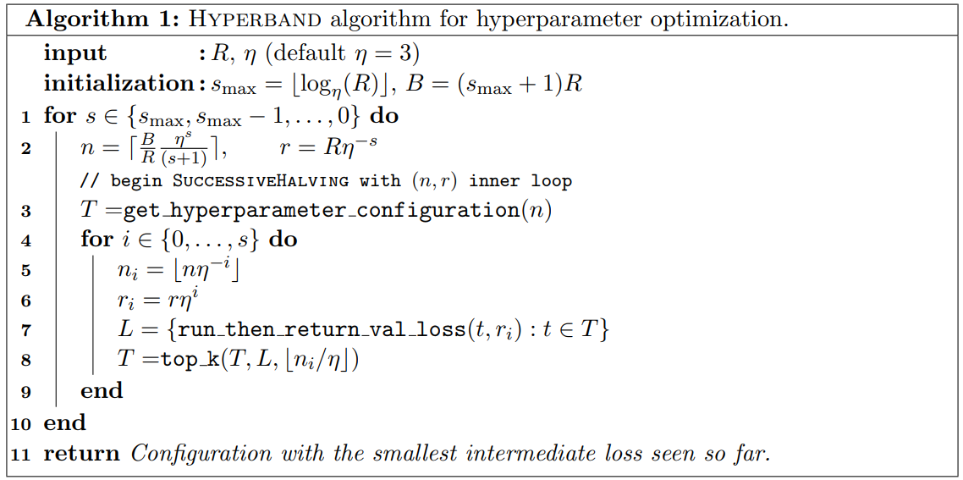
Hyperband (3)

Slide 21
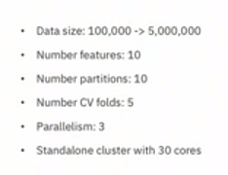
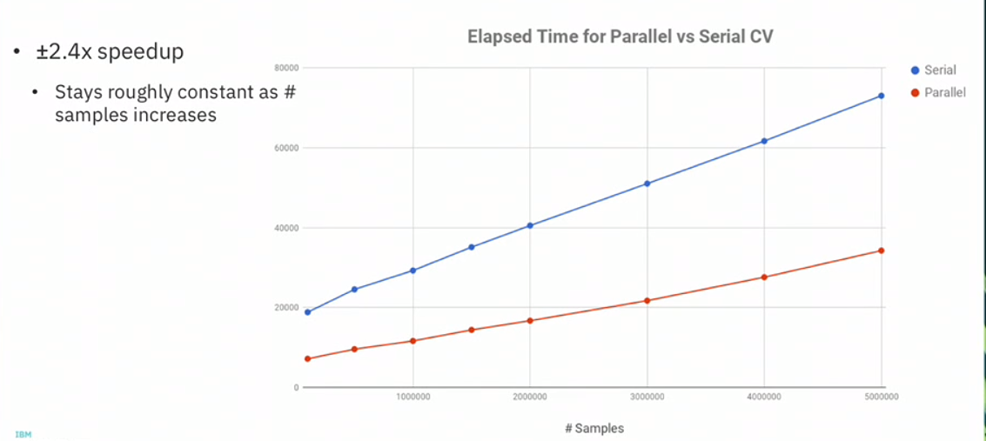
Model Parallelism (Spark ML Tuning)
Enabling model parallelism in Spark cross-validation - allowing for more than one model to be trained and evaluated at the same time
parallelism parameter controls the number of jobs sent to the Spark scheduler which can help to make better use of available cluster resources
The best approach is to shoot for having a few jobs in the queue to make sure all available resources are utilized, without overdoing it.

Slide 22
Model Parallelism (Spark ML Tuning)
Executer 1
Data
Partition 1
Task (Model 1)
Model 2
Model 1
Executer 2
Data
Partition 2
Task (Model 1)
Executer 3
Executer 4

Slide 23
Model Parallelism (Spark ML Tuning)
Executer 1
Data
Partition 1
Task (Model 1)
Model 1
Executer 2
Data
Partition 2
Task (Model 1)
Executer 3
Data
Partition 1
Task (Model 2)
Model 2
Executer 4
Data
Partition 2
Task (Model 2)

Slide 24
4) Implementation

Slide 25
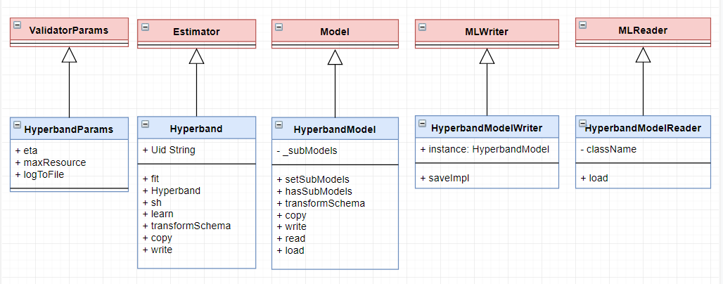
Spark Implementation (1)

Slide 26
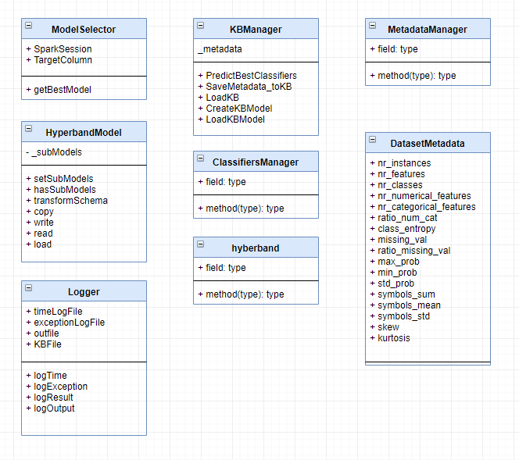
Spark Implementation (2)

Slide 27
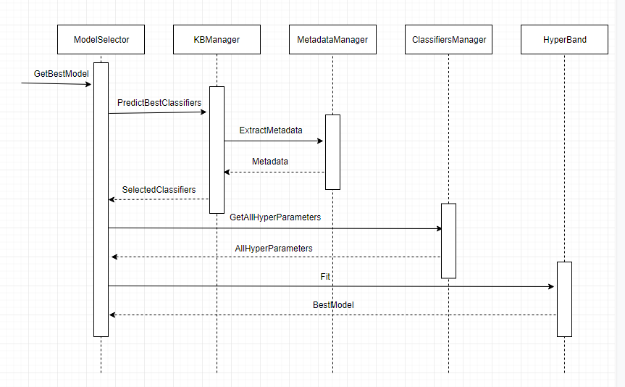
D-Smart Sequence Diagrams

Slide 28
5) Result

Slide 29
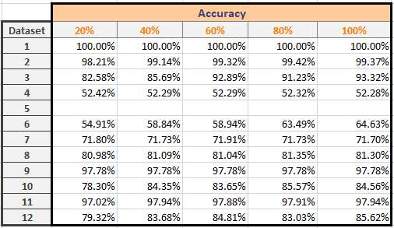
Accuracy vs. Data Percentage

Slide 31
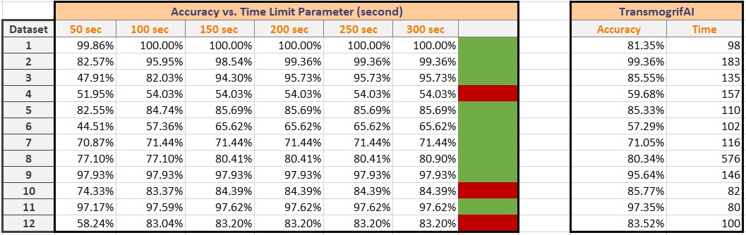
D-Smart ML vs. TransmogrifAI

Slide 32
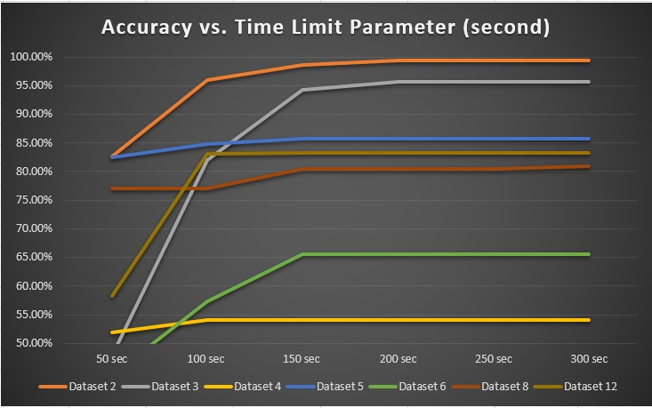
D-Smart ML vs. TransmogrifAI

